Slide 1


VOICE ASSISTANT
Performed by Mykyta Yevhenovych Kyselov, IP-13.

Slide 2
VOICE ASSISTANT

Slide 3

Objective -
A thorough analysis of the current state of the GP, identification of development prospects, and development of a concept for a new voice assistant aimed at meeting user needs in the context of a rapidly changing technological environment.

Slide 4

WORK PLAN
Introduction
Stages of implementation
Software development process
Technological analysis
Quality and safety assessment

Slide 5

Voice assistants: What they are and what they mean for marketing and commerce
CMUSphinx Documentation
GOOGLE ASSISTANT, SIRI, BIXBY, ALEXA, ЯКИЙ НАЙКРАЩИЙ?
Java Documentation
Sphinx-4 - Pure Java speech recognition library and others
LIST OF REFERENCES

Slide 6

GENERAL SCHEME OF THE GP OPERATION
Speech recognition
Selecting semantic objects
Module for executing commands
Text-to-Speech synthesis

Slide 7

MAIN DEVELOPMENT FUNCTIONS
NAME | DESCRIPTION
Voice search capability | The system should provide voice search capabilities.
Possibility of manual search | The system should provide the ability to perform a manual search.
Navigation menu | The system should provide the ability to switch to the main panel, the instructions for use panel, the author panel, the future use panel, and the license panel.
Providing text and voice access to services | The system should provide text and voice access to various services, such as search, weather, translation, music, joke generation, etc.
Providing the English language recognition function | The system should provide the ability to recognize English language to provide keyboard and voice input.
Guaranteeing the confidentiality of all requests | The system should ensure the confidentiality of all requests to protect the privacy of users.
Control panel | The system should provide the ability to close, resize, minimize, and drag the program window.

Slide 8


COMPARISON WITH THE ANALOG (ALEXA)
Vocalia
Alexa
Recognize voice commands
Recognize voice commands
Provision of information
Provision of information
Manage connected devices
Manage connected devices
Open-source code
Open-source code
No voice searches transmitted to third parties
No voice searches transmitted to third parties

Slide 9

COMPARISON WITH THE ANALOG (SIRI)
Vocalia
Siri
Recognize voice commands
Recognize voice commands
Integration with Apple products
Integration with Apple products
Personal assistant
Personal assistant
Open-source code
Open-source code
No voice searches transmitted to third parties
No voice searches transmitted to third parties

Slide 10

COMPARISON WITH THE ANALOG (GOOGLE ASSISTANT)
Vocalia
Google Assistant
Recognize voice commands
Recognize voice commands
Integration with Google products
Integration with Google products
Search for information online
Search for information online
Open-source code
Open-source code
No voice searches transmitted to third parties
No voice searches transmitted to third parties

Slide 11
COMPARISON WITH THE ANALOG (BIXBY)
Vocalia
Bixby
Recognize voice commands
Recognize voice commands
Integration with Samsung products
Integration with Samsung products
Open-source code
Open-source code
No voice searches transmitted to third parties
No voice searches transmitted to third parties

Slide 12
GENERAL SOFTWARE ARCHITECTURE

Slide 13

Main panel
Maintain the necessary information manually
Press the ENTER key
Wait for the assistant to respond
Get acquainted with the main panel
Find the information you need
Find information with voice search
Instructions panel
Familiarize yourself with the tools before using the application
Panel of authors
Meet the authors of the application
Future use panel
License panel
Get acquainted with the future use panel
Read the licenses of the programs included in the application

Slide 14
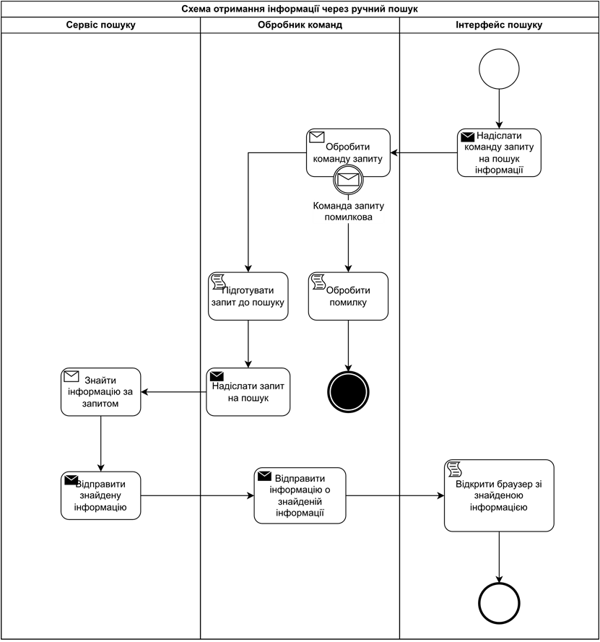
DIAGRAM OF THE BUSINESS PROCESS OF OBTAINING INFORMATION THROUGH MANUAL SEARCH

Slide 15
OPTIONS FOR USING THE SOFTWARE ARE GIVEN
Optional use of UC-01
Use case name - User login to the main page
Use case ID - UC-01
Goals - Successful user login to the home page
Actors - User
Trigger - User wants to log in to the home page
Pre-conditions - The user has the Vocalia application installed
Flow of Events - The user opens the Vocalia app, after which the home page opens and the user is taken to the home page.
Extensions - None.
Post-Condition - Downloading the voice assistant and other modules

Slide 16
Optional use of UC-02
Optional use of UC-03
Use case name - User login to the instructions page;
Use case ID - UC-02;
Goals - Successful user login to the instructions page;
Actors - User;
Trigger - The user wants to enter the instructions page;
Pre-conditions - The user has successfully logged into the application and is not on this page;
Flow of Events - The user is going to the instructions page;
Extension - Absent;
Post-Condition - Transition to the instructions page.
Use case name - User login to the instructions page;
Use case ID - UC-03;
Goals - Successful user login to the instructions page;
Actors - User;
Trigger - The user wants to enter the instructions page;
Pre-conditions - The user has successfully logged into the application and is not on this page;
Flow of Events - The user is going to the authors page;
Extension - None;
Post-Condition - Go to the authors page.

Slide 17

Optional use of UC-04
Optional use of UC-05
Use case name - User login to the future use case page;
Use case ID - UC-04;
Goals - Successful user login to the future use case page;
Actors - User;
Trigger - The user wants to log in to the future use page;
Pre-conditions - The user has successfully logged into the application and is not on this page;
Flow of Events - The user is going to the future use page;
Extension - None;
Post-Condition - Transition to the future use page.
Use case name - User login to the license page;
Use case ID - UC-05;
Goals - Successful user login to the license page;
Actors - User;
Trigger - The user wants to log in to the license page;
Pre-conditions - The user has successfully logged into the application and is not on this page;
Flow of Events - The user is going to the licenses page;
Extension - None;
Post-Condition - Transition to the license page.

Slide 18
Optional use of UC-06
Optional use of UC-07
Use case name - Find the information you need by manual search;
Use case ID - UC-06;
Goals - Successful finding of the required information by manual search;
Actors - User;
Trigger - The user wants to find the required information by manual search;
Pre-conditions - The user has successfully logged in to the application and is on the home page;
Flow of Events - The user enters the required query in the search field. Presses the <ENTER> key or the search icon. The user waits for the response from the GP;
Extension - If there is no Internet access, the search will be blocked and a corresponding message will be written;
Post-Condition - Creates a response to the user's request. It is voiced by voice.
Use case name - Finding the right information with voice search;
Use case ID - UC-07;
Goals - Successfully finding the information you need using voice search;
Actors - User;
Trigger - The user wants to find the required information using voice search;
Pre-conditions - The user has successfully logged in to the application and is on the home page;
Flow of Events - The user clicks on the voice search icon. Enters the required query by voice. The user waits for the response from the GP;
Extension - If there is no Internet access, the search will be blocked and a notification will be written about it;
Post-Condition - Creates a response to the user's request. It is voiced by voice.

Slide 19
DESCRIPTION OF UTILITIES
IntelliJ IDEA
The main software development environment for coursework.
Apache NetBeans
Software necessary for quick and easy creation of the front-end part of the term paper software.
Sphinx4
Sphinx4 is a speech recognition library designed for use in various projects. It is based on speech recognition technologies and provides an interface for integration with various speech applications. Sphinx4 can be used for real-time voice recognition, voice control command processing, and other speech-related tasks.

Slide 20
Swing
A library for developing a graphical user interface (GUI) in the Java programming language. This library provides a set of components and containers that allow you to create visually appealing and interactive programs. Swing is used to develop windowed applications where the user can interact with the program using a mouse, keyboard, and other devices.
FreeTTS
A library for speech synthesis in the Java programming language. It allows developers to create applications that can generate sound files or directly output speech to audio devices.
IPinfo
A library (and service) for obtaining information about IP addresses and geolocation. By using this service in your development, you can get data about the location of users, which can be useful for point analysis.

Slide 21
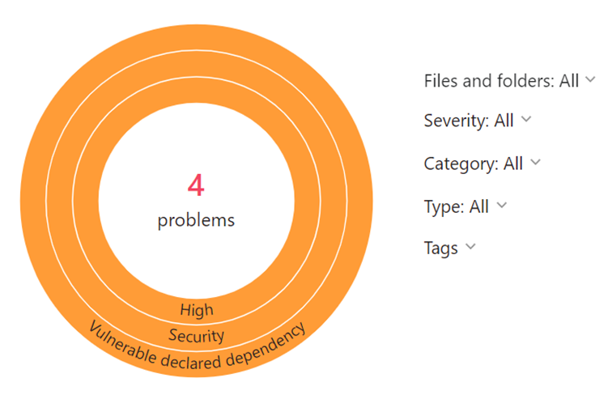
THE RESULT OF CODE ANALYSIS USING THE QODANA PLUGIN

Slide 22
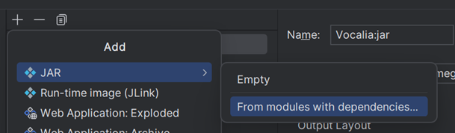
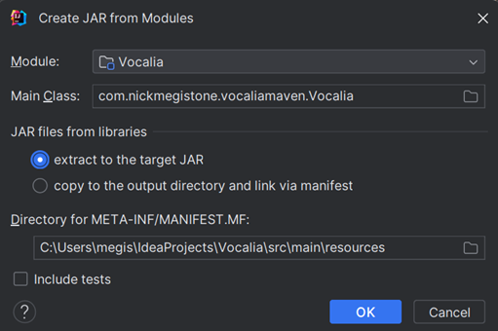
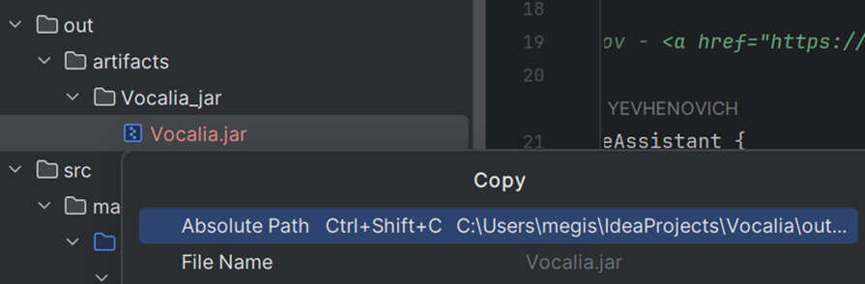
Creating a JAR artifact
Customize the created JAR artifact
Copy the full path of the created JAR file

Slide 23
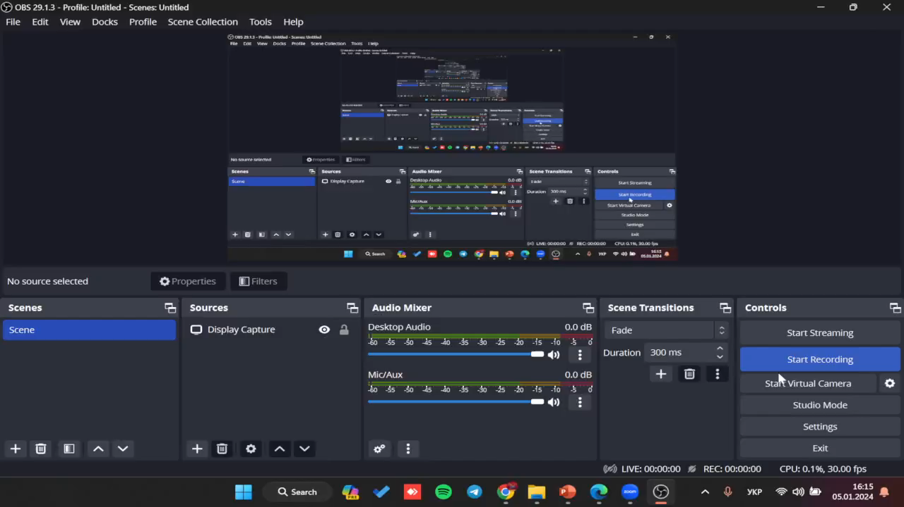
DEMONSTRATION

Slide 24




CONCLUSION
During the course work, a voice assistant "Vocalia" was developed that meets all the requirements and has high quality code and stable functionality. The results of analysis and testing have shown the effectiveness of software deployment and maintenance. For future development, it is proposed to expand the functionality, improve performance, and increase the security of the application. The Vocalia voice assistant opens opportunities to improve the availability of information and increase productivity and learning.

